Slide 1


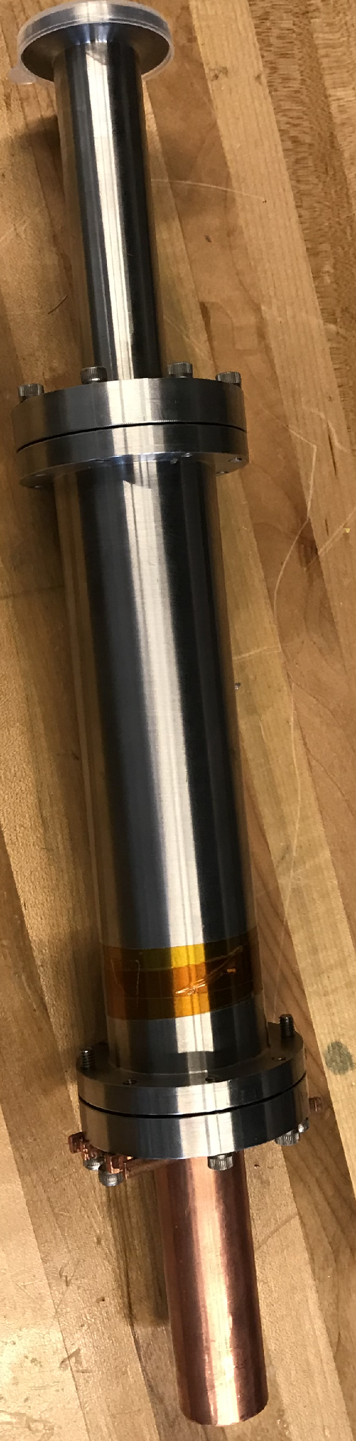
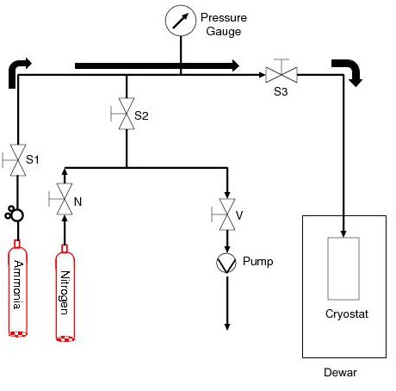
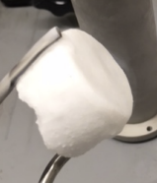
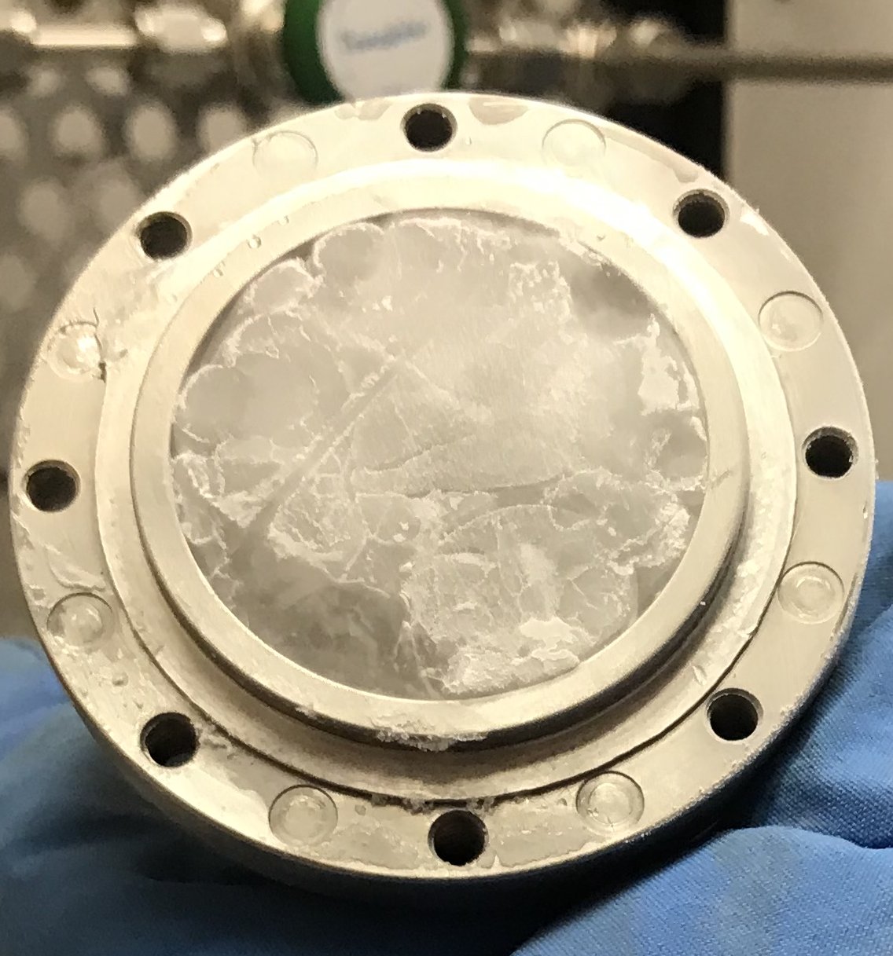
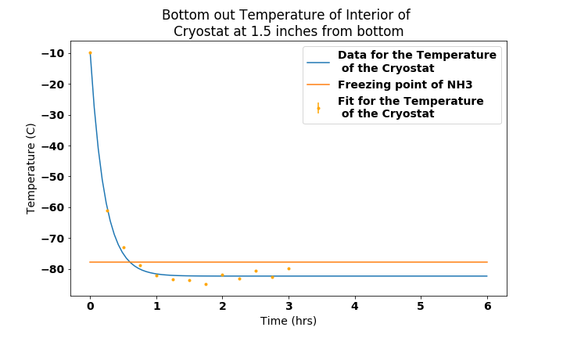
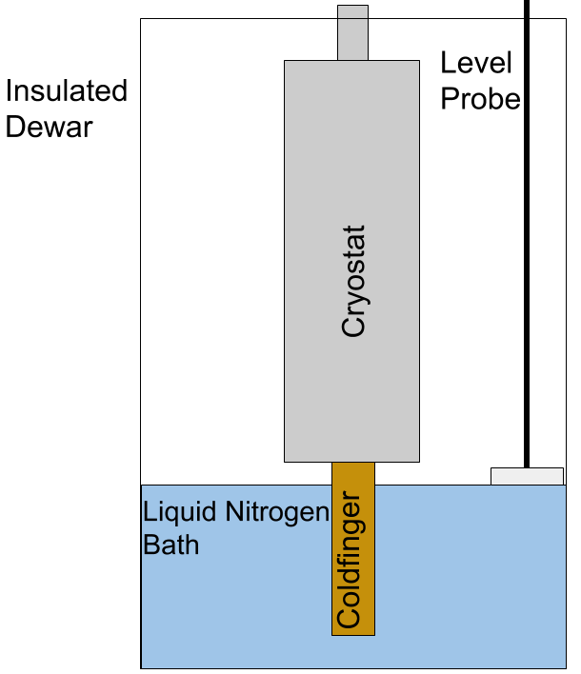
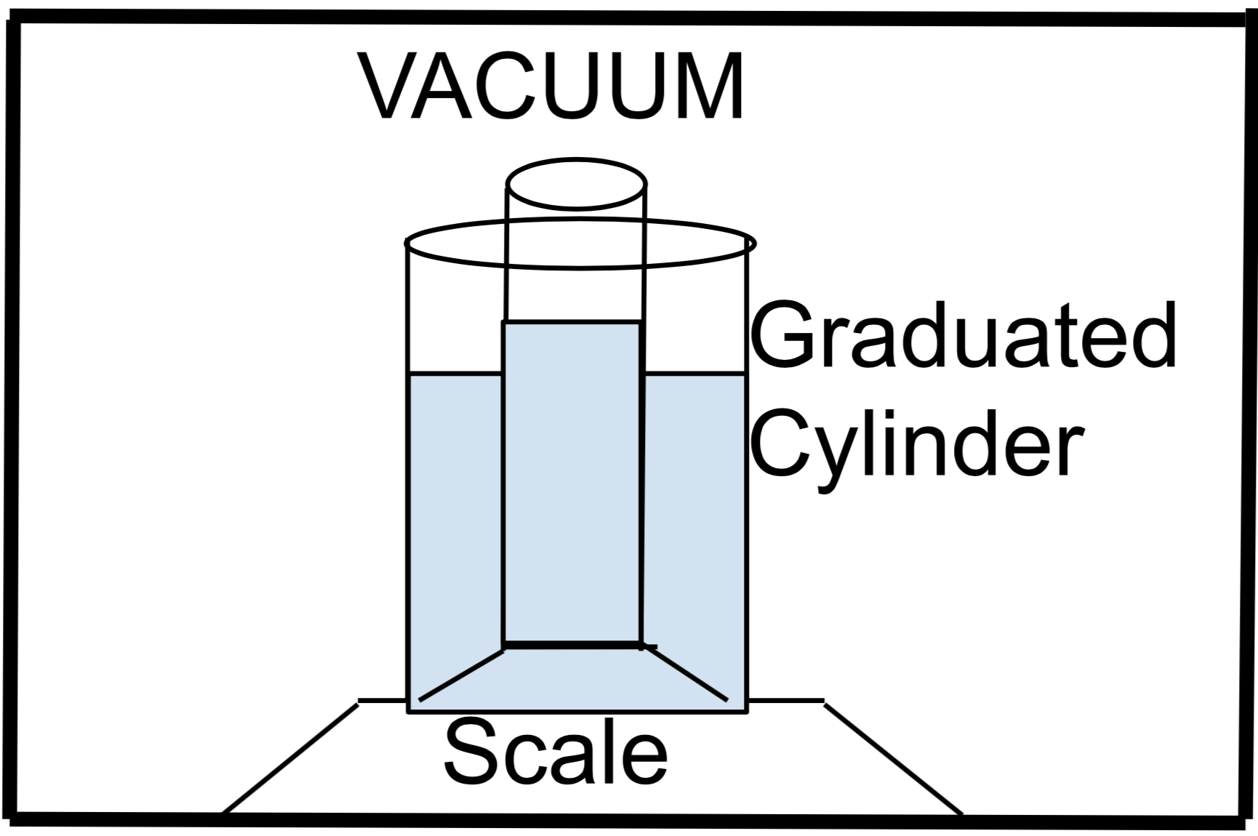
Solidification of Ammonia for Polarized Targets
Lucas Jameson|Advisor: Karl Slifer
University of New Hampshire
Department of Physics UNH Nuclear Physics Group
I. Introduction
Polarized targets are produced at Slifer Lab as part of the UNH NPG research program. The goal is to produce polarized targets with a Dynamic Nuclear Polarizer (DNP) that is used in the spin-dependent physics program at Jefferson Lab. Ammonia that has free radicals by irradiation and is polarized by Dynamic Nuclear Polarization is a common polarized target. A method for slowly cooling the ammonia in the cryostat was
III. Process
As gaseous ammonia flows into the freezing chamber, it deposits heat into the walls and begins to liquify. A pool of liquid ammonia forms on the bottom of the freezing chamber first and then a solid slowly begins to grow from that. To ensure that the cold finger is working properly, the entire copper rod must remain under liquid nitrogen. This allows the cold finger to remain at a constant temperature and to optimize performance. After the solidification process has finished, typically several hours for half the freezing chamber to be filled, the material is harvested from the freezing chamber and crushed and sorted into ~2mm beads. These are then stored in 30 mL Nalgene bottles and stored in liquid nitrogen until they get irradiated and polarized.
IV. Results
The new process was able succeeded in getting the interior of the freezing chamber to just below the temperature. This in turn created a more transparent solid that was more difficult to crush. The former process used liquid nitrogen as a cooling bath and with a boiling point of -195 C, the interior walls of the cryostat were brought to well below the freezing point of ammonia, -77 C. This new method uses a heatsink to bring the temperature of the interior walls to -83 C, just below the freezing point of ammonia.
The density of a cryogenic solid like solid ammonia can be measured with 1% uncertainty by using a vacuum chamber with a 25 mL beaker with 0.1 mL uncertainty nested in a bath of liquid nitrogen and a scale with 0.1g uncertainty,. This device shown in Figure x, is still in the testing phase and is yet ready to work with ammonia.
designed to introduce less of a thermal gradient between the the walls of the cryostat and the freezing point of ammonia which is about -77 C. Prior method used liquid nitrogen as a cooling bath which introduced a larger thermal gradient since nitrogen boils at -195 C. The purpose for slow freezing ammonia is to make a higher density solid. A higher density solid polarized target means more targets to scatter off of and produces data and better statistics.
Temperature (C)
Figure 1. - The large stainless steel cylinder is where the ammonia is solidified..
Figure 4. – Bottom: The solid ammonia produced using the cold finger method.
The material is a white, powdery material. Top: Solid ammonia made using the liquid nitrogen cold bath. The material is clear and much more difficult to break.
Figure 4. – The bottom out temperature of the interior of the freezing chamber. This is just below the freezing point of ammonia.
Liquid Nitrogen Freezing Process | White and powdery Brittle amorphous solid Cloudy
Cold Finger Freezing Process | Clear and transparent Durable crystalline solid Glassy
Figure 2. – Flow of ammonia through the gas panel into the freezing chamber.
II. Design
The cold finger system is submerged in a bath of liquid nitrogen and acts as a heatsink to cool down the interior walls of the freezing chamber to 195 K which is the freezing point of ammonia. The level of liquid nitrogen in which the cold finger sits is to be maintained such that the entire copper rod is fully submerged at all times. A dewar with a level probe is used to ensure that the level of liquid nitrogen remains constant by periodically adding liquid nitrogen to the dewar.
The density of the material can be measured using Archimedes principal where the fluid used to measure the displaced volume is liquid nitrogen. In order to make accurate measurements on the volume of liquid nitrogen in
Table 1. – Overview of the properties of the material frozen using the two methods. First the method of liquid nitrogen cooling bath, second, the copper cold finger heat sink method.
V. Conclusions & Future
Future work includes adding thermometry to the system so that the freezing chamber can be maintained at a certain temperature. Quantitative analysis of the density of the solid ammonia produced from both methods will be performed in the following weeks.
Figure 3. – Schematic of the system used to measure the density of a cryogenic solid.
Acknowledgements:
I would like to thank Slifer lab and Long lab for providing the means and resources used throughout this project
the graduated cylinder, the whole system in placed in a rough vacuum.
Figure 3. – The level of liquid nitrogen is maintained at 7 cm from the bottom and the cold finger acts as a heatsink.

Slide 2
Solidification of Ammonia for Polarized Targets
Lucas Jameson
Advisor: Karl Slifer

Slide 3
Background
Polarized Targets are used to study the spin structure of the proton
Not sure what pic to put here

Slide 4
Design and Construction
Create higher density ammonia for polarized targets
The cryostat and the cold finger fully assembled
Schematic of the gas panel used to solidify ammonia

Slide 5
Implementation
Using this method to make solid ammonia
Functionality of the Cold finger method
Desnity measurement apperatus
Schematic of Cold finger method

Slide 6
Results
Design of process for creation of new structure
Density measurement of cryogenic solid
Liquid Nitrogen Freezing Process | White and powdery Brittle amorphous solid Cloudy
Cold Finger Freezing Process | Clear and transparent Durable crystalline solid Glassy
Top: Solid ammonia made via cold finger method.
Bottom: Solid ammonia made via liquid nitrogen bath method.

Slide 7
Conclusion and References
Stuff
More Stuff
Poeple and papers....

